Slide 1
Korea and NOSAP Partnership
Hoon Sang Lee, MD, MPH
Yonsei University School of Public Health
KOICA (Korea Int’l Cooperation Agency)
Notes:
Korea and NOSAP Partnership

Slide 2
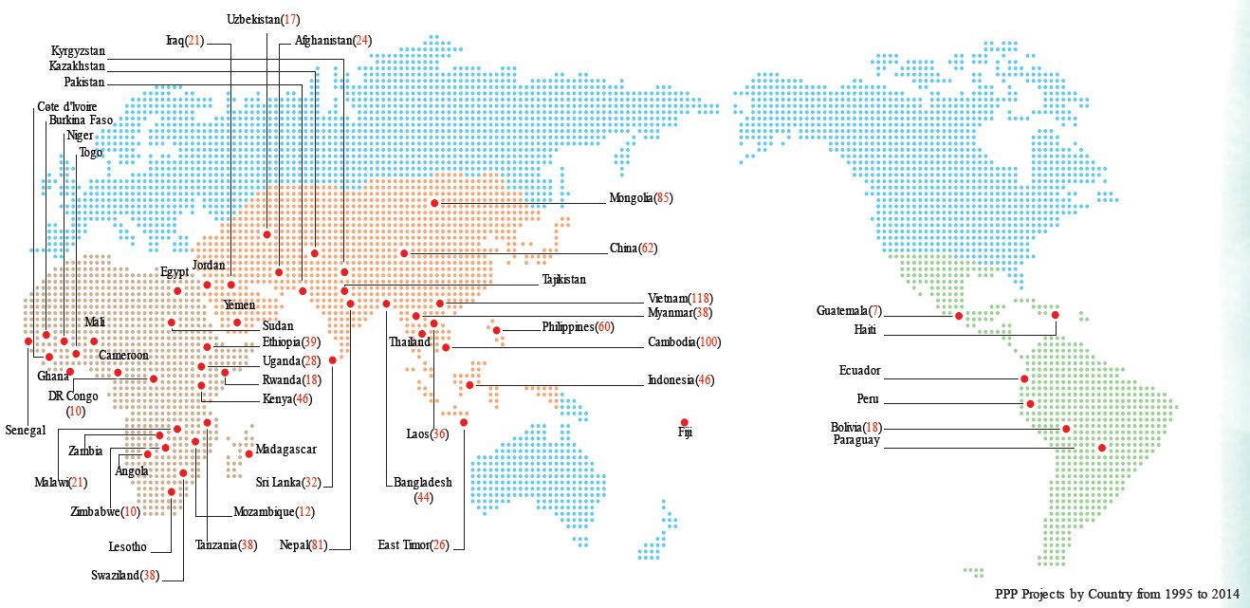
KOICA Partnership Map for 20 Years

Slide 3
Growth in Volume of Korean ODA
Unit: 1 million Korean Won
$1=1,000 KW

Slide 4
KOICA Health Strategy 2016-2020
Notes:
건강권, 건강형평성, 보편적 건강보장 이라는 명제와
SDG 목표와의 연계성, 다양한 보건이슈들 중에서 우리가 할 수 있고, 또 잘 할 수 있는 것에 선택과 집중 하기로 했습니다.

Slide 5
Essentials of Korea’s Health ODA
Evidence based approach
Population based/ Public health approach
Health system approach
Strengthening monitoring and evaluation

Slide 6
KOICA CHPS+ Project
Project Name | Project for improving community-based primary health care through CHPS strengthening in Upper East Region (CHPS+)
Budget | 9 million USD
Duration | 2016-2020
Location | Ghana, Upper East region
Site | 120 CHPS compounds 48 health centers 6 district hospitals

Slide 7
Theory of Change

Slide 8
Major concepts & components
(KOICA draft design Jan. 2015)
CHV Concept and Roles
with Enhanced Training
RHMT
/DHMT
Sustainable Monetary & Non-monetary Incentive Packages
Health System Strengthening
Enhanced Engagement of CHMC and Community
Improved
Health Service
Community Emergency Transportation System
Community Engagement
Health Service Improvement (CHPS compound & HC)
CHPS
Enhanced CHPS-based
Health Information System
CHV
CHO
Governance and Leadership
(SHMT, DHMT, RHMT)
CHV is enhanced with improved training, motivation & supervision.
Community
*CHO: Community Health Officer
*CHV: Community Health Volunteer
*CHAP: Community Health Action Plan
*CHMC: Community Health Management Committee
*DHMT: District Health Management Team
*HC: Health Center
*RHMT: Regional Health Management Team
*SHMT: Sub-district Health Management Team
Notes:
약어

Slide 9
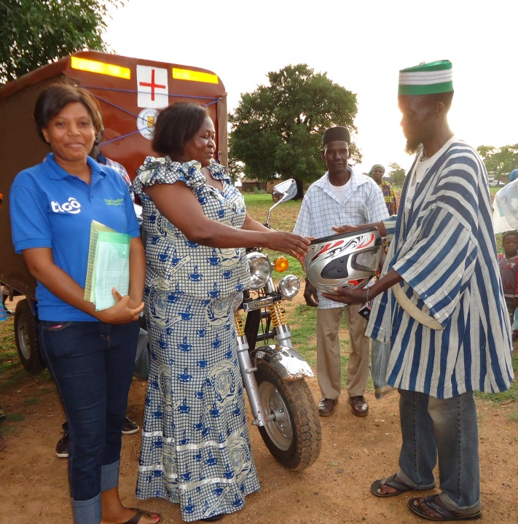
Ghana Essential Health Interventions Program (GEHIP)
GEHIP was introduced as a coordinated response for addressing challenges and facilitating the scale up of CHPS in response to the Ministry of Health Evaluation report (Binka et al., 2009) on the status of CHPS.

Slide 10
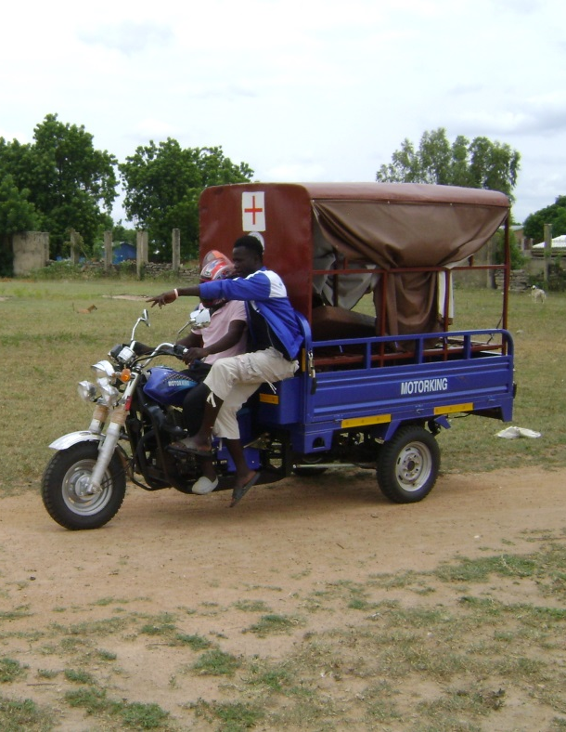
Ghana Essential Health Interventions Program (GEHIP) Impact Evaluation
HMIS data suggest a significant decline in facility-based maternal mortality during the intervention period that was more pronounced in communities with “Sustainable Emergency Referral Care” (SERC)
 | IRR | SE | Wald | Pr(>|W|)
SERC | 2.21 | 0.186 | 18.14 | <0.001 | ***
period | 0.86 | 0.261 | 0.35 | 0.552
SERC:period | 0.36 | 0.508 | 4.11 | 0.043 | *
Note: Results are from poisson GEE model of MMR from monthly birth and death tallies by facility. Repeated measures are treated using exchangeable correlation structure and robust standard errors.

Slide 11
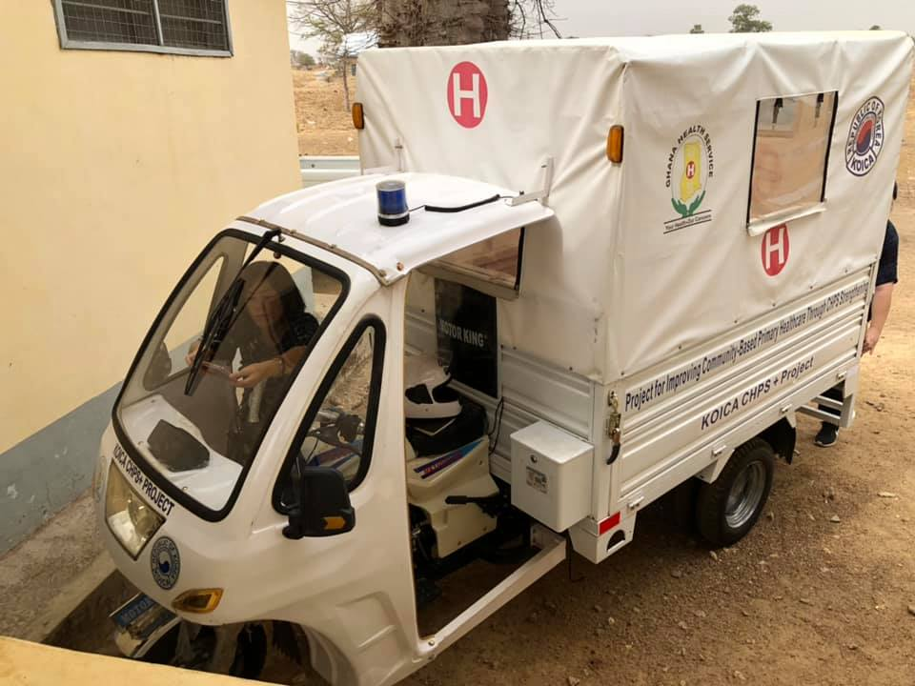
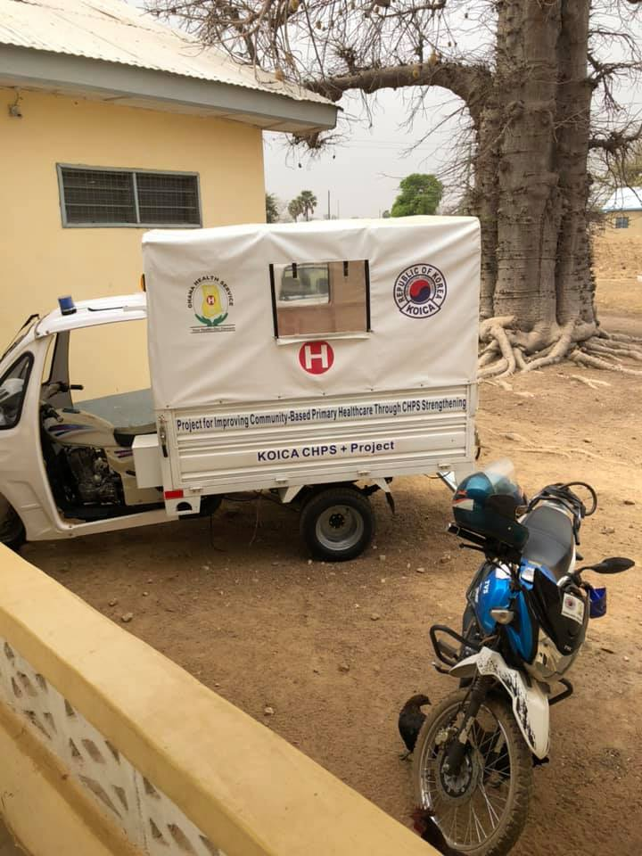
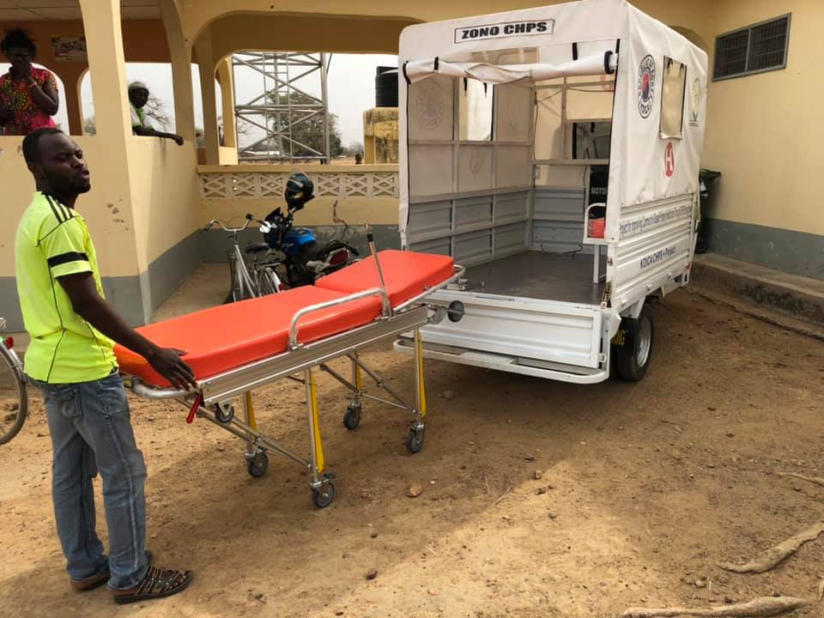

Slide 12
Impact Evluation of SERC

Slide 13
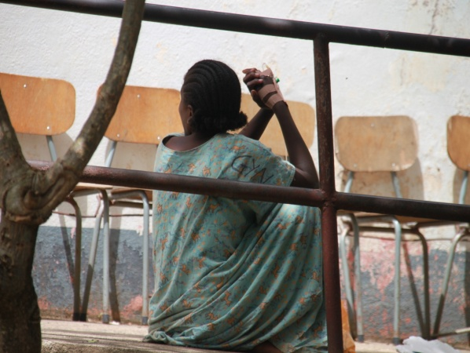
Fistula Support through UNFPA
Fistula
Project name: Cote d'Ivoire UNFPA Fistula Project Phase 1
Duration/Amount: : 2010-2015/ 1.7 million USD
Contents : Surgical support for women with fistula, support for social reintegration and readjusting to community
Project name: Cote d'Ivoire UNFPA Fistula Project Phase 2
Duration/Amount: 2016-2018/ 10.2 million USD
사업효과 : Prevention of occurrence of female fistula patient, provision of surgical care, scale up of program for social reintegration back to community

Slide 14
Further thoughts on NSOAP
Financing and sustainability aspect
(Following recurrent cost)
Coordinate and harmonize with
other priorities
Coordinate and harmonize with other priorities
Place surgery into existing program

Slide 15
New Way Forward
Innovation and technology
Private and Public Partnership
Impact investment and social venture model

Slide 16
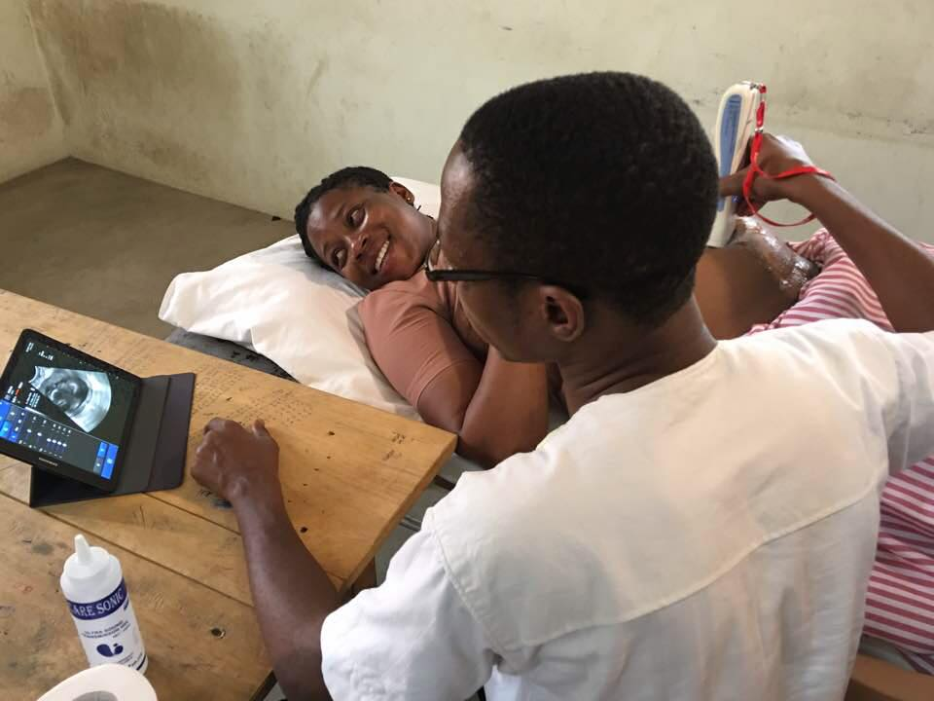
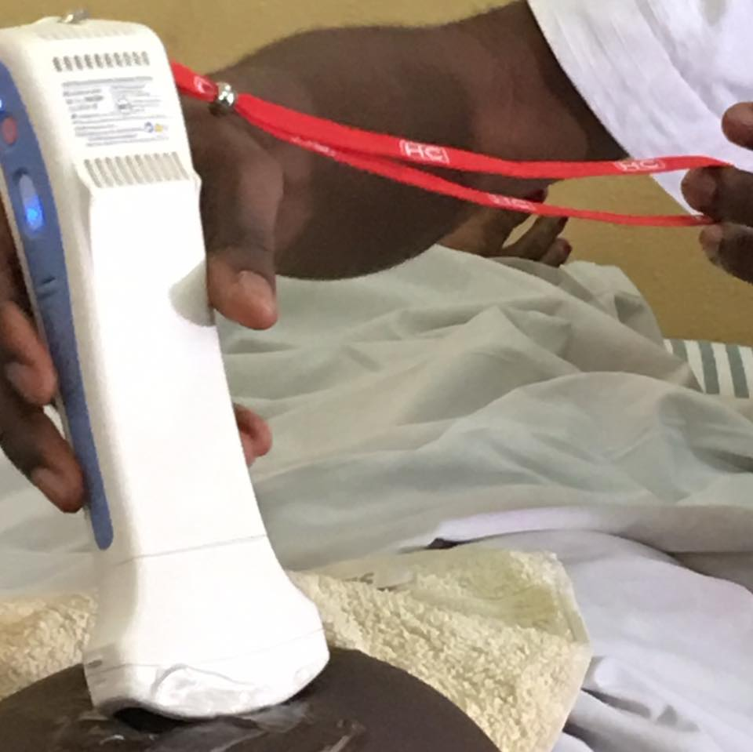
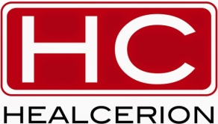
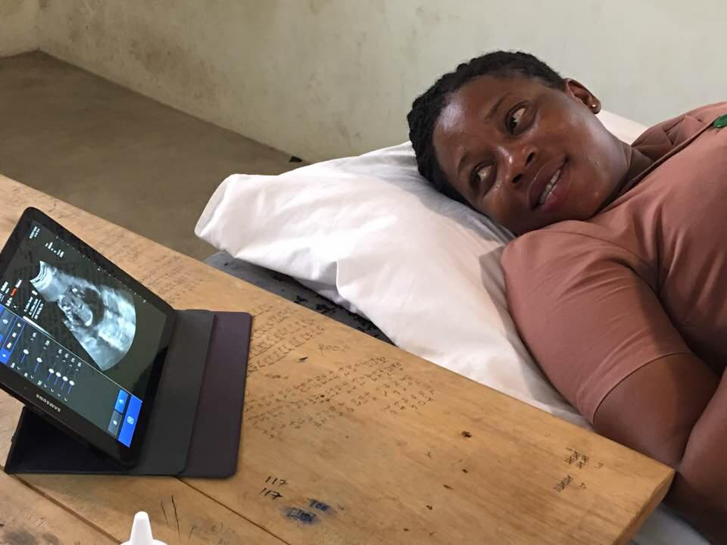

Slide 17
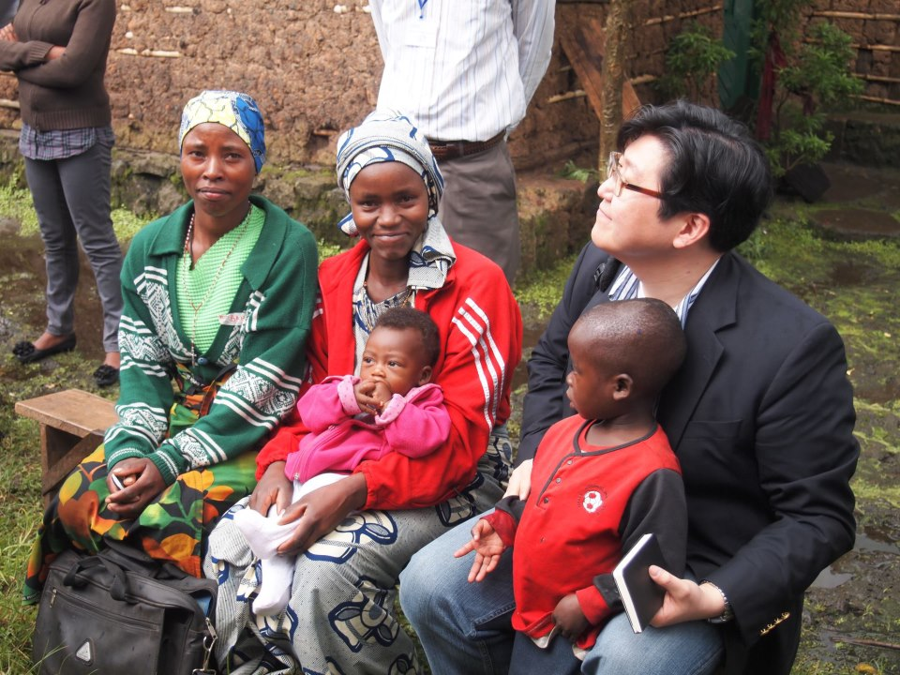
Thank you

